Slide 1

Interpretable ai
Dr. Sanket Mishra, SCOPE

Slide 2
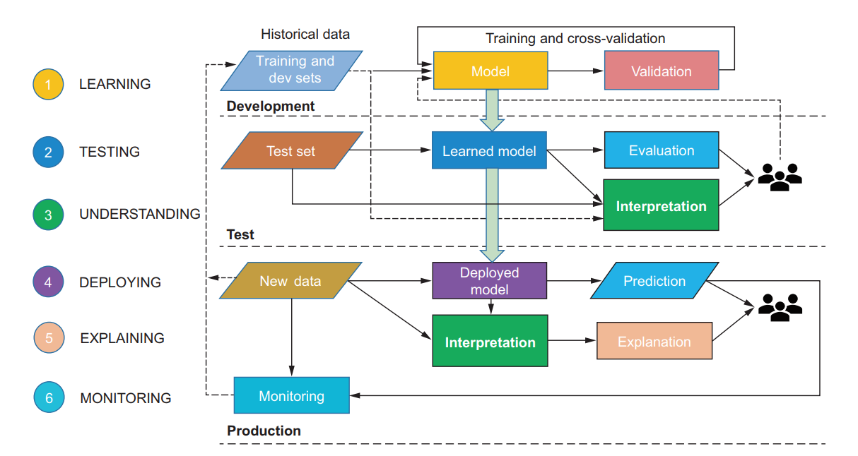
Methodology

Slide 3
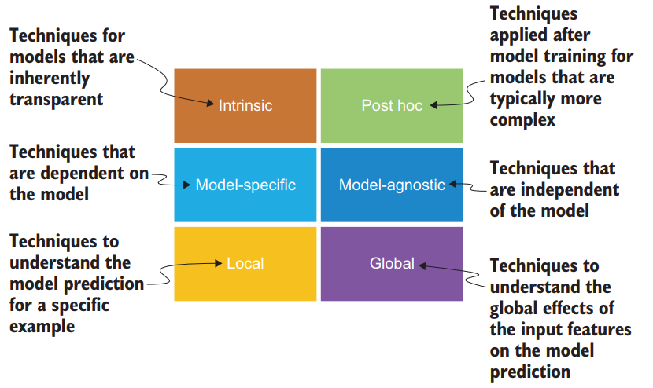
Model interpretability paradigms

Slide 4
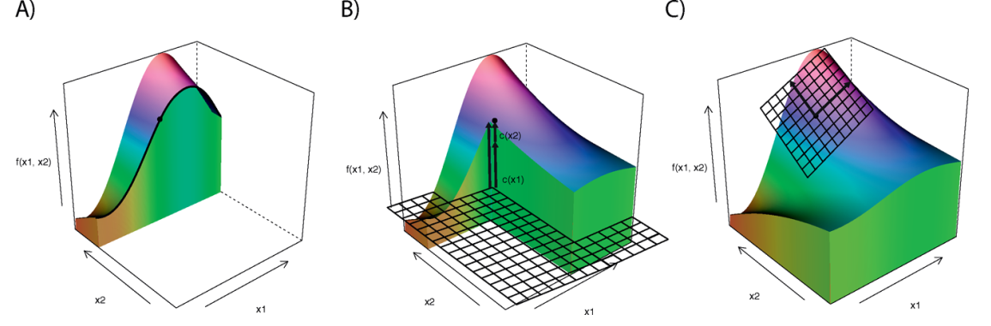
Instance-based explainations

Slide 5
Breakdown plots
Probably the most commonly asked question when trying to understand a model’s prediction for a single observation is: which variables contribute tothis result the most? There is no single best approach that can be used to answer this question. In this chapter, we introduce break-down (BD) plots, which offer a possible solution. The plots can be used to present “variable attributions”, i.e., the decomposition of the model’s prediction into contributions that can be attributed to different explanatory variables.

Slide 6
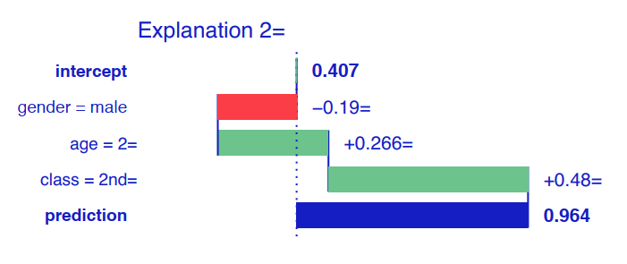
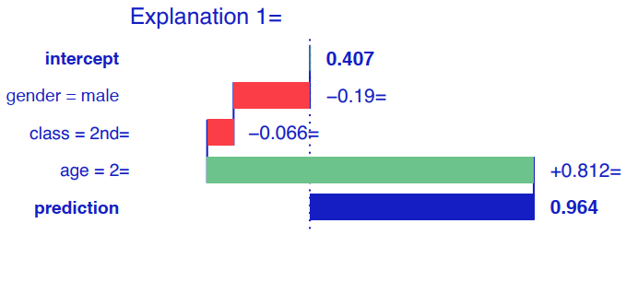
Interpretation of titanic dataset ???

Slide 7

Mathematical inferences

Slide 8
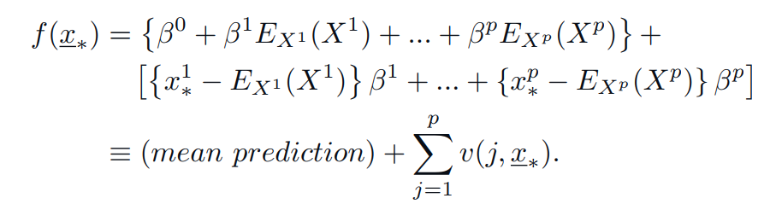
Mathematical inferences

Slide 9
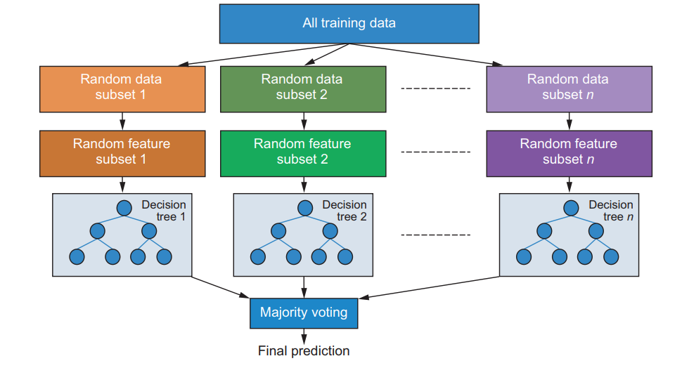
Random forest

Slide 10
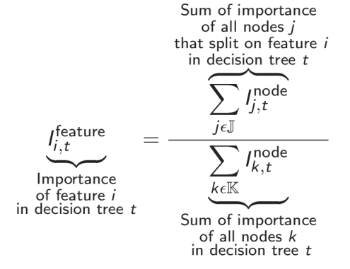
Random forest : interpretation

Slide 11
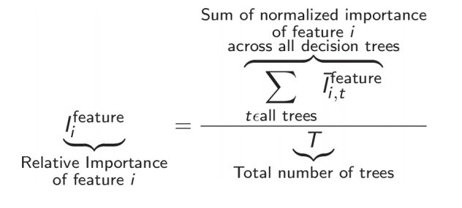
Feature importance rf

